Slide 1
Computer documentary
By Naitik

Slide 2
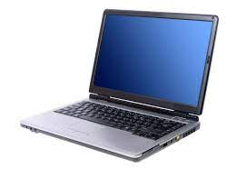
What is computer
A computer is an electronic device that manipulates information, or data. It has the ability to store, retrieve, and process data. You may already know that you can use a computer to type documents, send email, play games, and browse the Web.

Slide 3
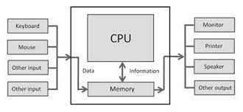
What is in computer
At a high level, all computers are made up of a processor (CPU), memory, and input/output devices. Each computer receives input from a variety of devices, processes that data with the CPU and memory, and sends results to some form of output.

Slide 4
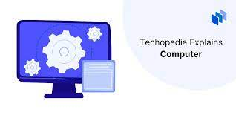
What is computer short word
an electronic machine that is used for storing, organizing, and finding words, numbers, and pictures, for doing calculations, and for controlling other machines: a personal/home computer.

Slide 5
What are the 4 main computer
Classification of Computers by Size
Supercomputers.
Mainframe computers.
Minicomputers.
Personal computers (PCs) or microcomputers.

Slide 6
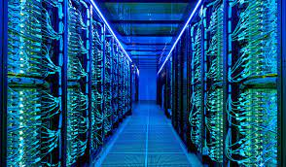
What is supercomputer
Supercomputer, any of a class of extremely powerful computers. The term is commonly applied to the fastest high-performance systems available at any given time. Such computers have been used primarily for scientific and engineering work requiring exceedingly high-speed computations

Slide 7
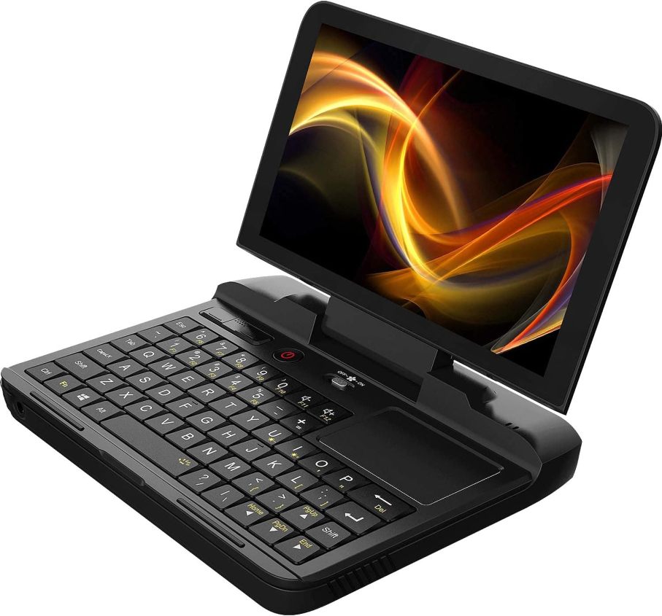
What is minicomputer
minicomputer, computer that was smaller, less expensive, and less powerful than a mainframe or supercomputer but more expensive and more powerful than a personal computer. Minicomputers were used for scientific and engineering computations, business transaction processing, file handling, and database management.

Slide 8
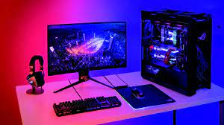
What is personal computer
A personal computer, often referred to as a PC, is a computer designed for individual use. It is typically used for tasks such as word processing, internet browsing, email, multimedia playback, and gaming.

Slide 9
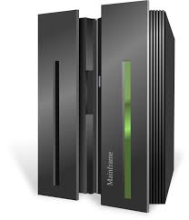
What is mainframe computer
A mainframe, also known as big iron, is a high-performance computer used for large-scale, compute-intensive purposes and tasks that require greater availability and security than smaller-scale machines
.

Slide 10
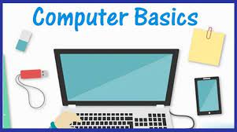
What is basic computer
Computers consist of hardware components such as the central processing unit (CPU), memory, storage devices, input/output devices, and peripherals, as well as software components such as the operating system and applications.2

